Slide 1
Assignment #9
Balance Trees – Due November 1st
Label steps and use a tool (not handwritten)
No late assignments

Slide 2
#1 Insertion into a 2-4 Tree
Insert 15, 35, 25, 55, 45, 85, 95, 65, 75 into a 2-4 tree

Slide 3
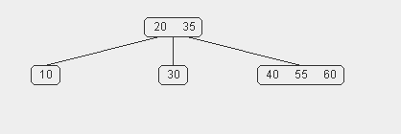
#2 Delete from a 2-4 Tree
Remove node 35 from this 2-4 tree

Slide 4
#3 Insertion into a Red-Black Tree
Insert 15, 35, 25, 55, 45, 85, 95, 65, 75 into a red black tree

Slide 5
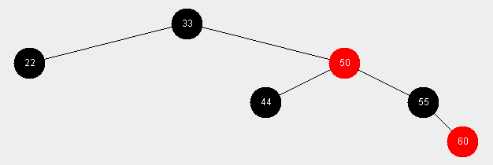
#4 Remove from a Red-Black Tree
Delete 55 and then 22 from this red black tree (show all steps)

Slide 6
#5 Remove from a Red-Black Tree
Remove 50 and then 55 from this red black tree (show all steps)

Slide 7
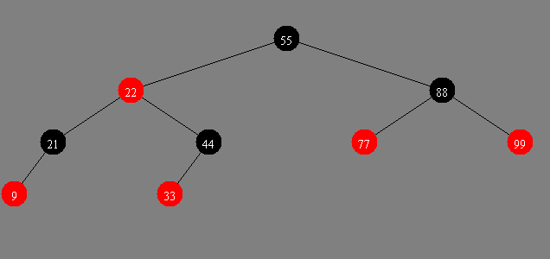
#6 Remove from a Red-Black Tree
Remove 22 (show all steps)

Slide 8
#7 Conversion
10
4
14
2
6
12
18
8
16
20
Convert this red-black tree to a 2-4 tree

